Slide 1



CROP AND FERTILIZER RECOMMENDATION SYSTEM

Slide 2
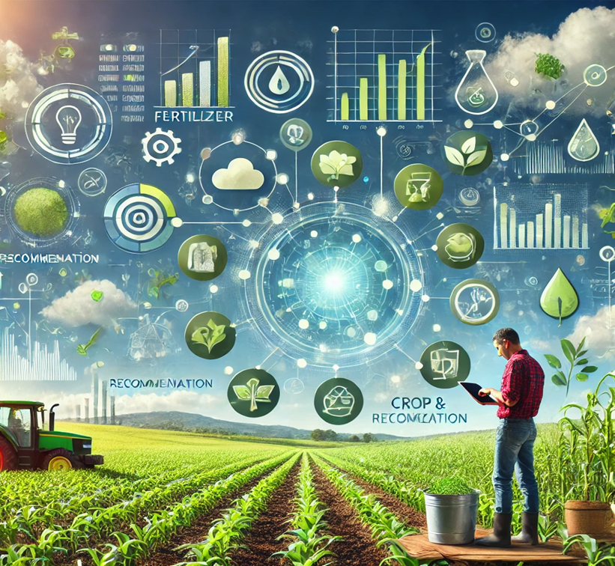

Learning Objectives
The Crop and Fertilizer Recommendation System uses advanced machine learning techniques to analyze soil characteristics, weather conditions, and crop requirements. It is designed to:
Recommend the best crop suitable for a given piece of land.
Suggest appropriate fertilizers to optimize yield while maintaining soil health.
Provide actionable insights for sustainable agriculture practices.
GOAL
Source :
www.freepik.com/

Slide 3
Tools and Technology used
The Crop and Fertilizer Recommendation System utilizes advanced tools and technologies:
1. Machine Learning Models:
🡪Supervised learning techniques to analyze soil data, weather conditions, and crop requirements.
🡪Algorithms such as Decision Trees, Random Forests, and Support Vector Machines (SVM) are employed for classification and regression tasks.
2. Data Collection and Pre-processing:
🡪Integration of soil and weather data ensures recommendations are based on real-time and historical patterns.
🡪Feature Engineering: Extracts meaningful insights from agricultural datasets for model training.
3. Frontend and Backend Frameworks:
🡪Streamlit: Used for deploying the frontend and backend, providing an interactive and streamlined interface for user interaction. Streamlit ensures quick and efficient visualization of data and ML model outputs, making the system user-friendly and easily accessible.
4. Artificial Neural Networks (ANN):
🡪Used to process complex patterns in agricultural datasets, improving prediction accuracy for crop and fertilizer recommendations.

Slide 4
5. Recommender System Architecture:
🡪Combines machine learning models with historical farming practices to provide personalized and optimized recommendations.
🡪Models are trained on datasets to predict the most suitable crop and the precise quantity of fertilizers required.
6. Visualization and User Experience:
🡪Streamlit’s interactive features provide an intuitive platform for users to interact with the system.
🡪Charts, graphs, and tables display predictions, soil health analysis, and resource utilization for better decision-making.
7. Deployment and Scalability:
🡪Streamlit Deployment: Ensures ease of use and accessibility, even for non-technical users, with a focus on simplicity and effectiveness.
🡪Scalable deployment ensures that the system can handle multiple users simultaneously.
8. Sustainability Focus:
🡪Promotes eco-friendly farming by prioritizing sustainable crop recommendations and minimizing resource wastage.

Slide 5
Methodology
The methodology for the Crop and Fertilizer Recommendation System involves leveraging machine learning techniques and data analysis to provide accurate recommendations for optimal crop selection and fertilizer usage.Steps in the CNN model methodology.
Import libraries: Import libraries like Pandas, NumPy, Scikit-learn, Matplotlib, and Streamlit.
Set up directory structure: Organize the project into folders for datasets, scripts (data preprocessing, model training, and evaluation), and deployment files.
Data Preparation: Clean and preprocess the collected datasets.
🡪Split the data into training, validation, and testing subsets.
Feature Selection and Engineering: Identify key features like soil properties (e.g., nitrogen, phosphorus, potassium), climate variables (e.g., temperature, rainfall), and crop attributes.
Train Machine Learning Models: Develop classification models (e.g., Random Forest, SVM) for crop prediction based on input conditions.
🡪Train regression models (e.g., Linear Regression, XGBoost) for fertilizer quantity recommendation.
6.Evaluate the Models: Evaluate model performance using metrics such as accuracy, precision, recall, and RMSE.
🡪Use k-fold cross-validation to ensure generalization.

Slide 6
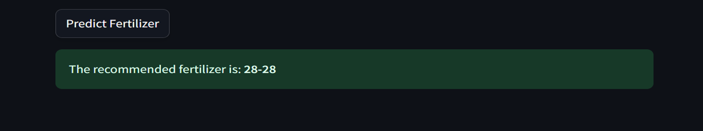
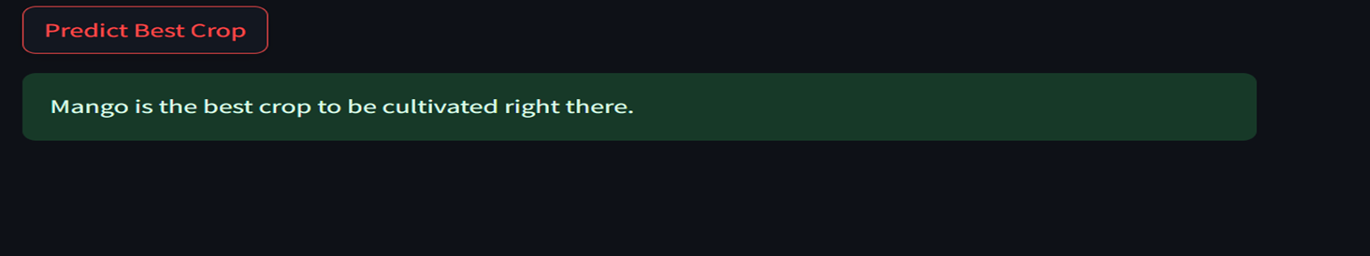
7.Develop the User Interface: Build an intuitive user interface using Streamlit, enabling users to input soil and climate data and receive recommendations.
8.Deployment and Testing: Deploy the project using Streamlit for seamless user access.
🡪Test the system under real-world scenarios to validate its effectiveness.
9.Feedback Integration: Gather feedback from users and retrain models periodically to improve system performance.

Slide 7
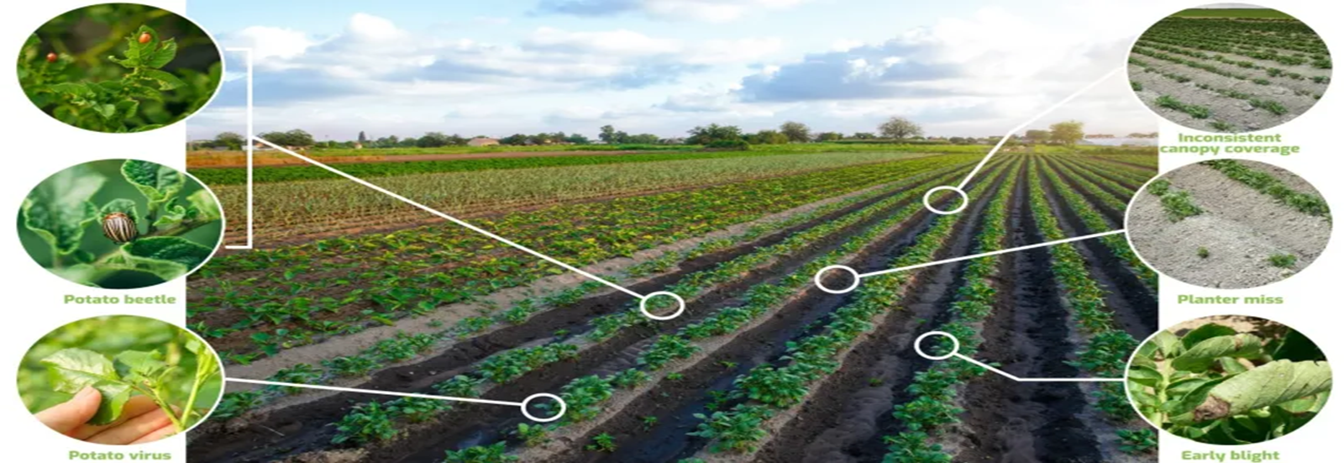
Problem Statement:
The problem statement for the Crop and Fertilizer Recommendation System is to design and implement a machine learning-based solution that provides farmers with accurate recommendations for optimal crop selection and appropriate fertilizer usage. This system should analyze soil properties, climatic conditions, and other relevant data to improve agricultural productivity and promote sustainable farming practices.

Slide 8
Solution:
The Agriculture Prediction App integrates machine learning algorithms to provide actionable insights for farmers. The app offers two key functionalities:
1. Prediction Type Selection:
i) Crop Prediction: The app allows users to determine the best crop to cultivate based on the input parameters provided.
ii) Fertilizer Prediction: Offers suggestions for fertilizers tailored to the soil and crop needs to enhance productivity.
2. Input Fields:
i) Nitrogen (N), Phosphorus (P), and Potassium (K): Users enter values representing the soil's nutrient content. These nutrients are crucial for plant growth and yield.
ii) Additional factors such as temperature, humidity, and rainfall may also be included in future iterations to enhance prediction accuracy.
3. Simple and Interactive UI:
i) The app is built using Streamlit, a powerful framework for creating web-based data applications.
ii) User-Friendly Design: The interface is intuitive, allowing users to interact effortlessly with input fields for Nitrogen (N), Phosphorus (P), and Potassium (K).

Slide 9
iii) Input Widgets:
Text Fields: For entering precise nutrient values.
Radio Buttons: To select between "Crop Prediction" or "Fertilizer Prediction" options.
Slider Inputs: Optional for range-based values (e.g., temperature or humidity).
Dark Theme: The app's modern dark-themed UI provides better readability and focus for users.
Real-Time Updates: As users input data, predictions are generated and displayed instantly.
4. Output Insights:
i) After entering data and selecting the prediction type, the app processes the input through trained machine learning models.
ii) Result: Displays the recommended crop and fertilizer in a user-friendly format, empowering users to make informed decisions.
Significance of the Output:
i) For Farmers: Provides actionable insights that directly enhance agricultural efficiency, reduce costs, and optimize resources.
ii) For Agricultural Stakeholders: Enables better planning and resource allocation to achieve sustainable farming practices.

Slide 10
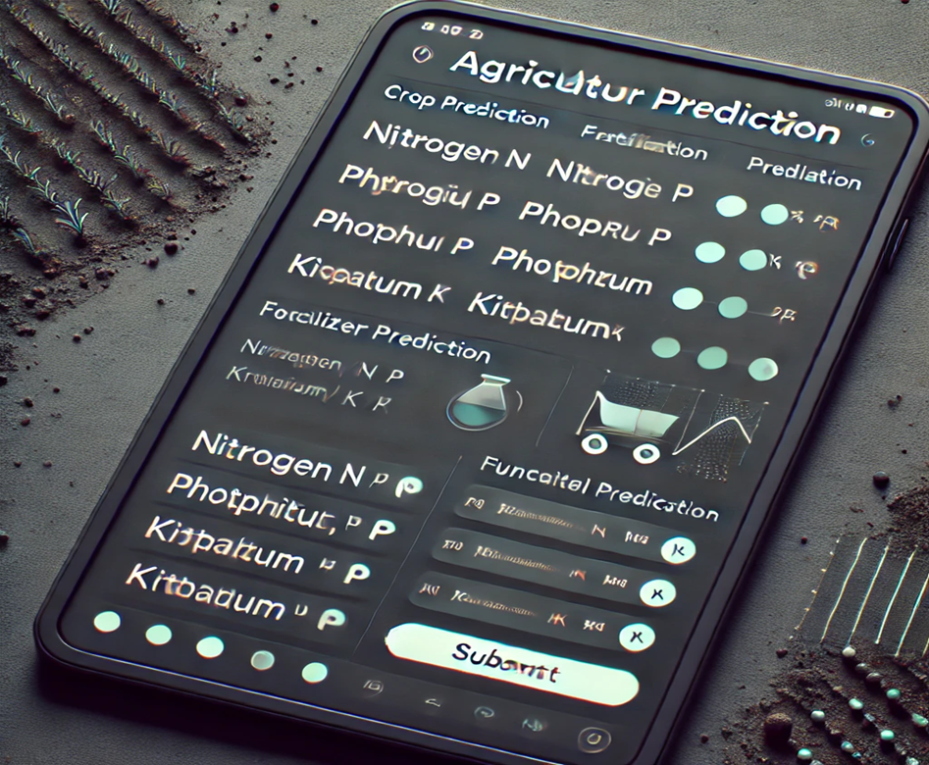
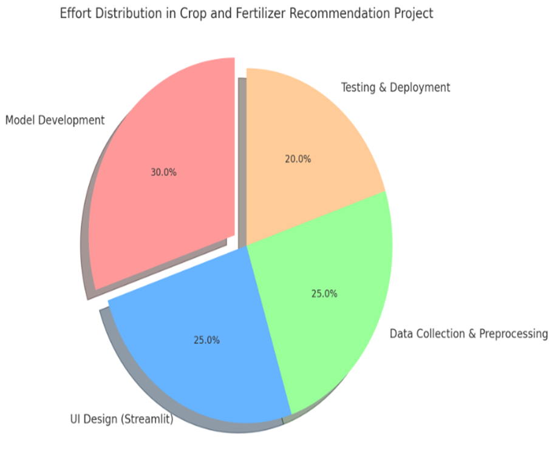

Slide 11
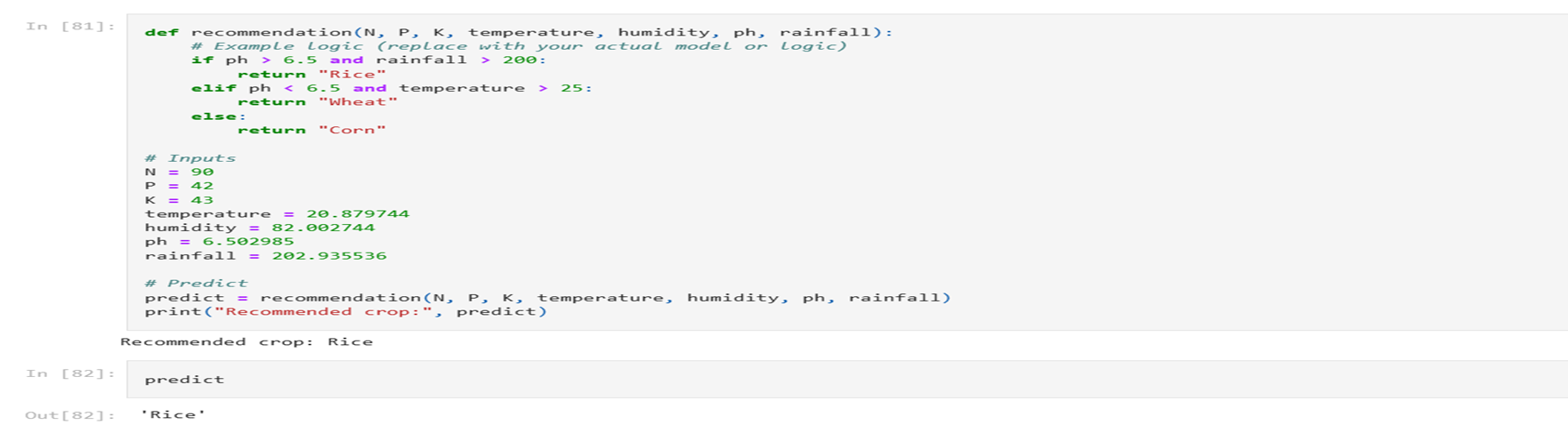
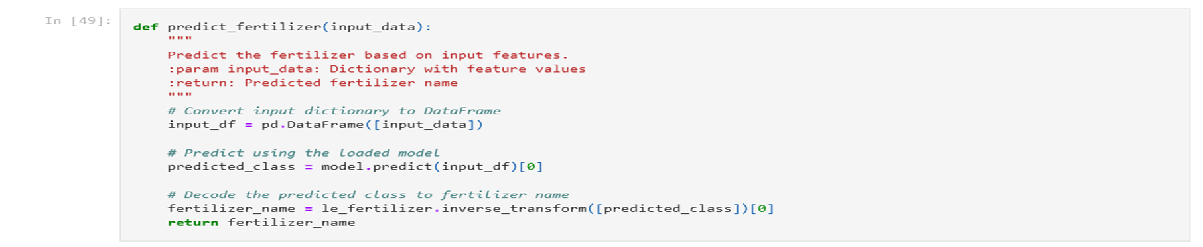
Screenshot of Output:

Slide 12
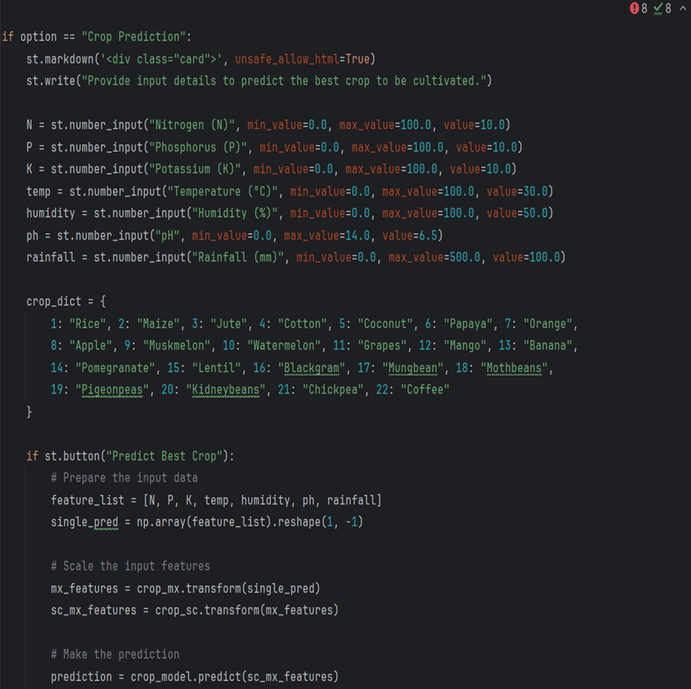
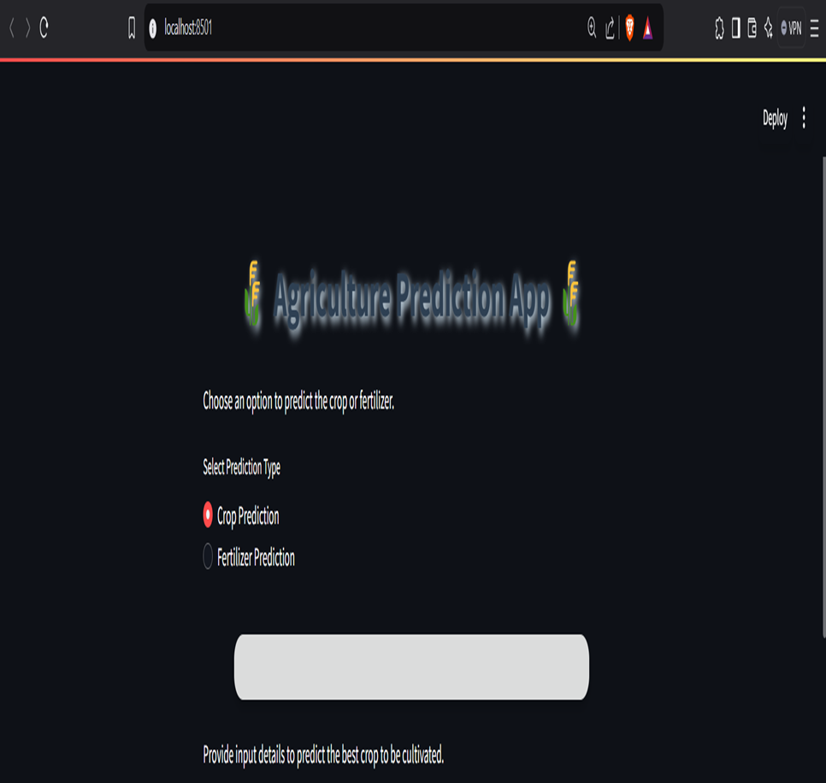

Slide 13
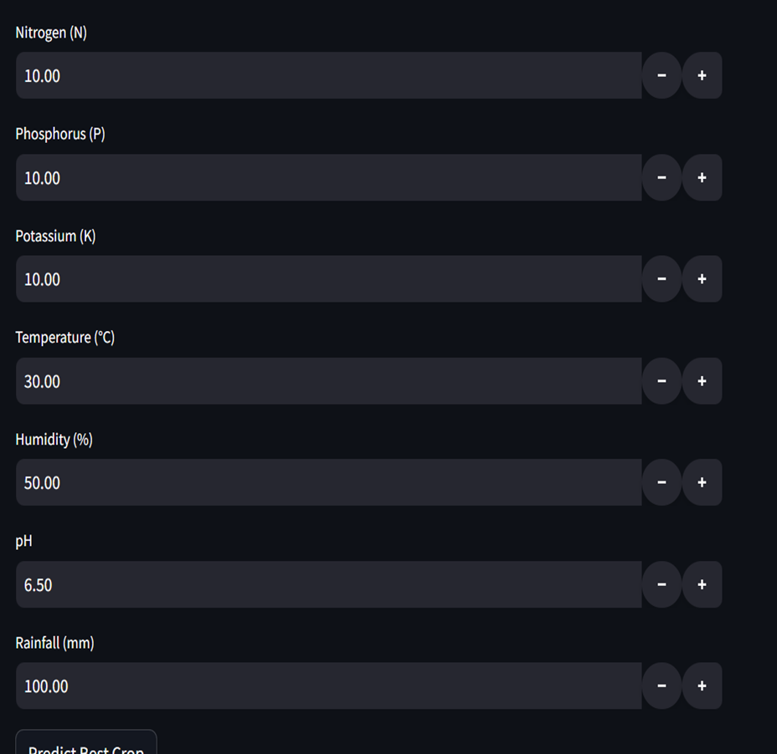
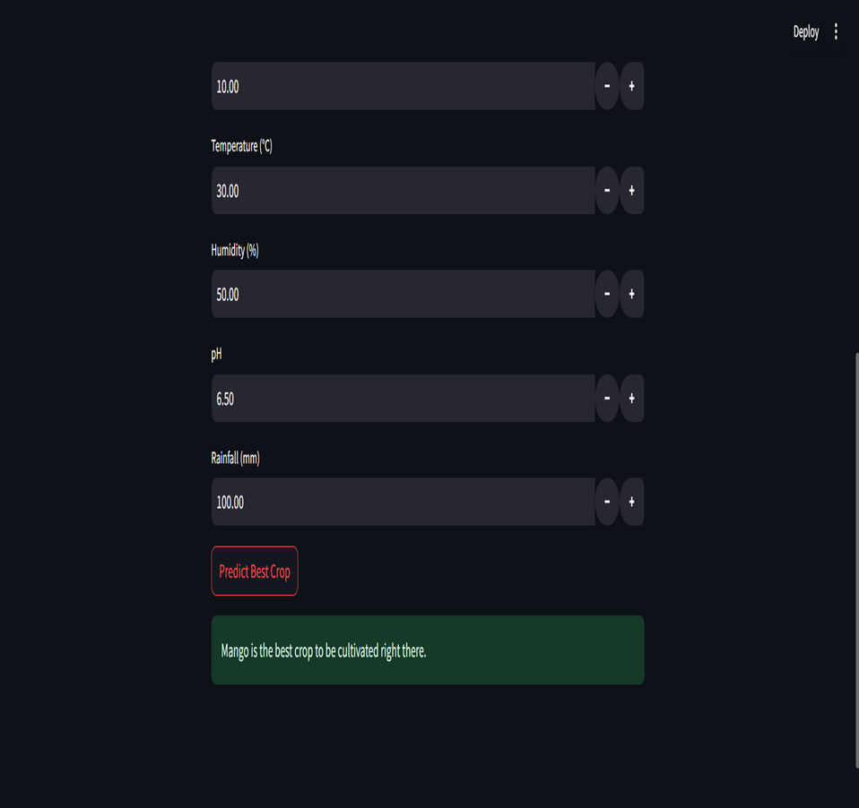

Slide 14
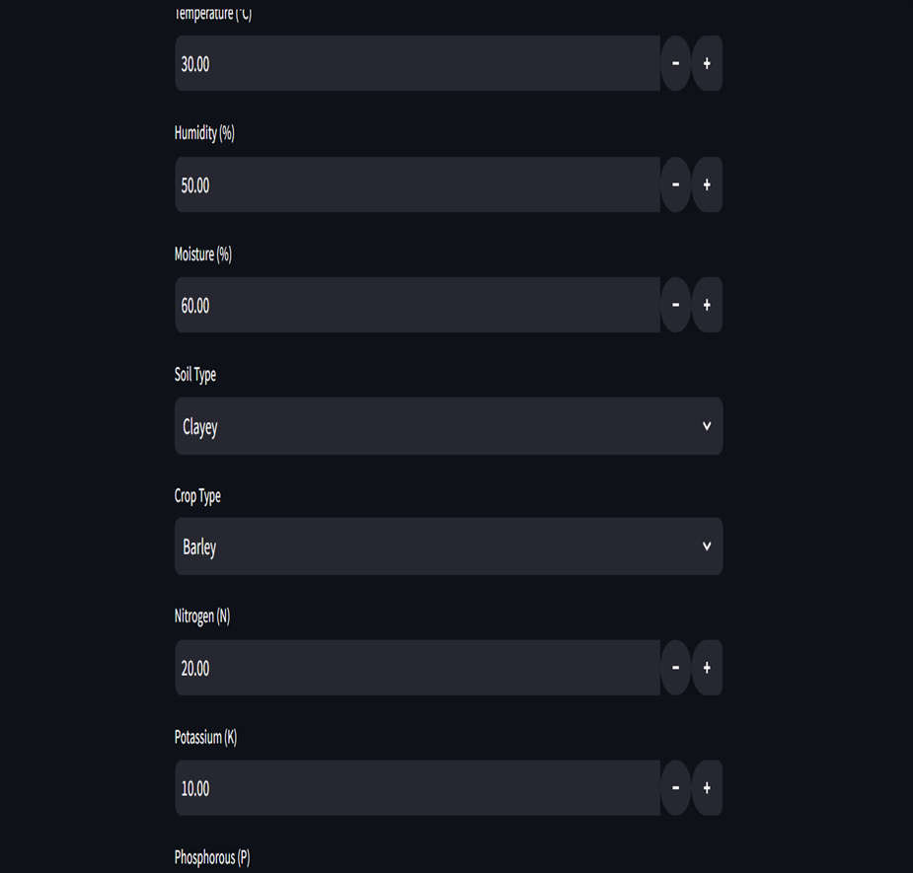
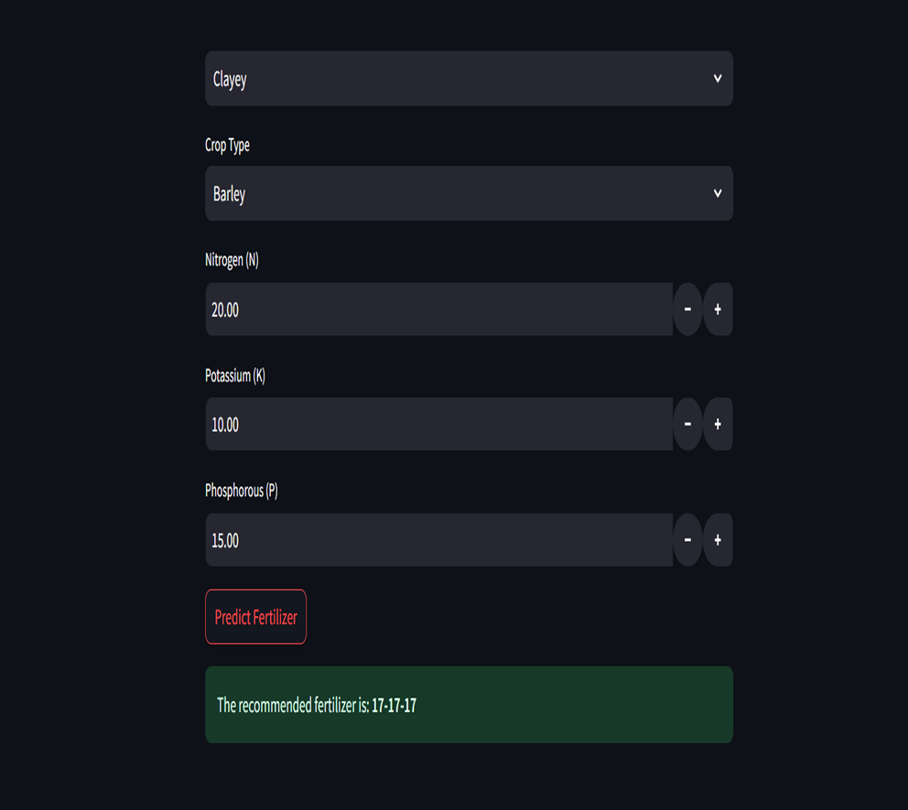

Slide 15
Conclusion:
Machine learning plays a transformative role in agriculture by providing data-driven insights for better crop management and resource utilization. The Crop and Fertilizer Recommendation System developed in this project highlights the potential of integrating technology in agriculture.
Enhanced Decision-Making: By analyzing soil nutrients and environmental factors, the system assists farmers in selecting optimal crops and fertilizers.
Scalability: The model is built to handle diverse agricultural data and can be adapted for various geographical regions.
Streamlit Integration: The use of Streamlit for the interface ensures a user-friendly experience, enabling seamless interaction and real-time recommendations.
Future Enhancements: The system can incorporate additional features such as pest management, weather forecasting, and market price predictions to further support farmers.
Sustainability: Promotes efficient use of fertilizers and resources, contributing to sustainable farming practices.
This project demonstrates the potential of AI and machine learning in revolutionizing traditional farming techniques and driving agricultural innovation.

Slide 16
Github Link:- https://github.com/Tejaskakade02/crop-and-fertilizer-recommendation-system-using-machine-learning-.git

